Slide 1
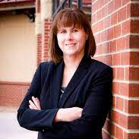

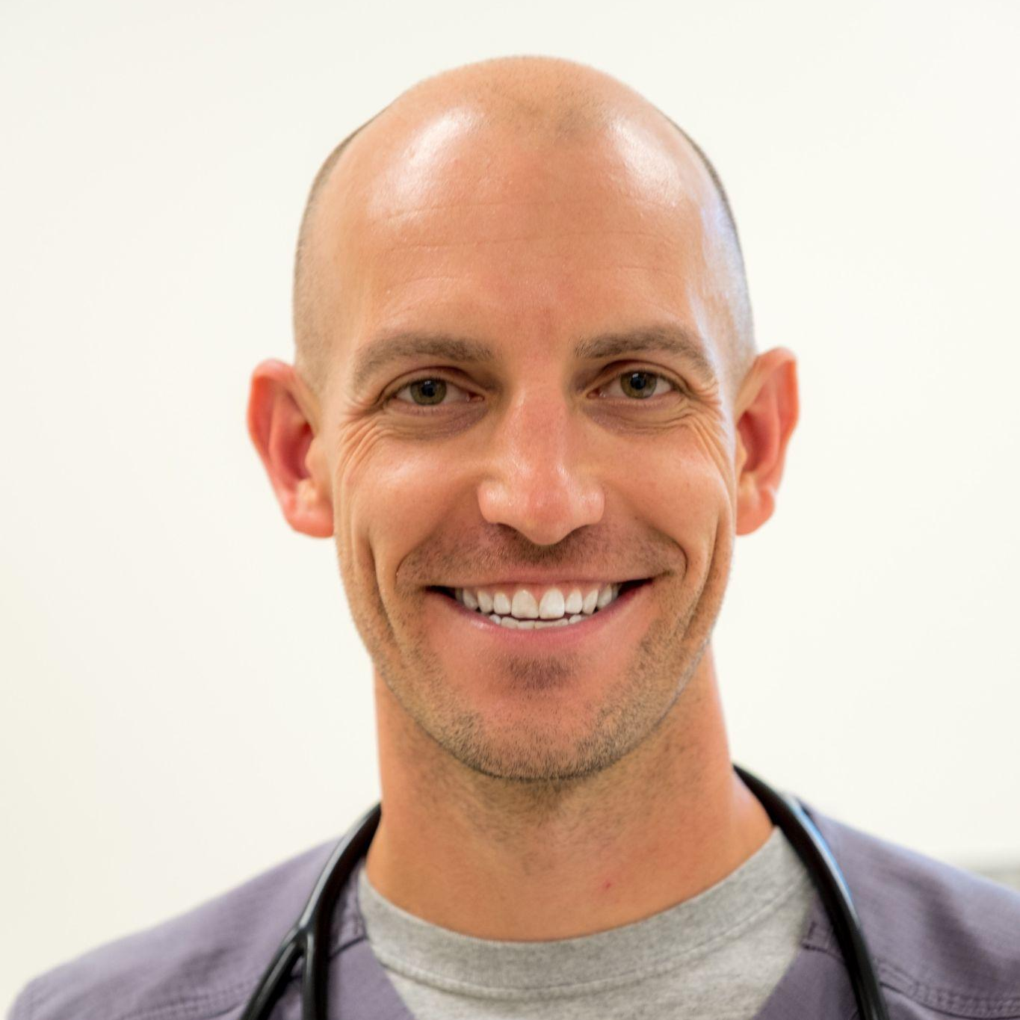
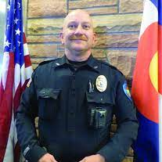


San Luis Valley, Colorado
Heather Brooks, Alamosa City Manager Carey Deacon, Program Director, CRP
Dr. J. Ely Walker, MD MPH Chief Dale Meek, Chief of Police, Town of Center
Kenna Gonzales, 12th Judicial Probation Officer Gail Garcia-Kuhns, Intensive Case Manager

Slide 2
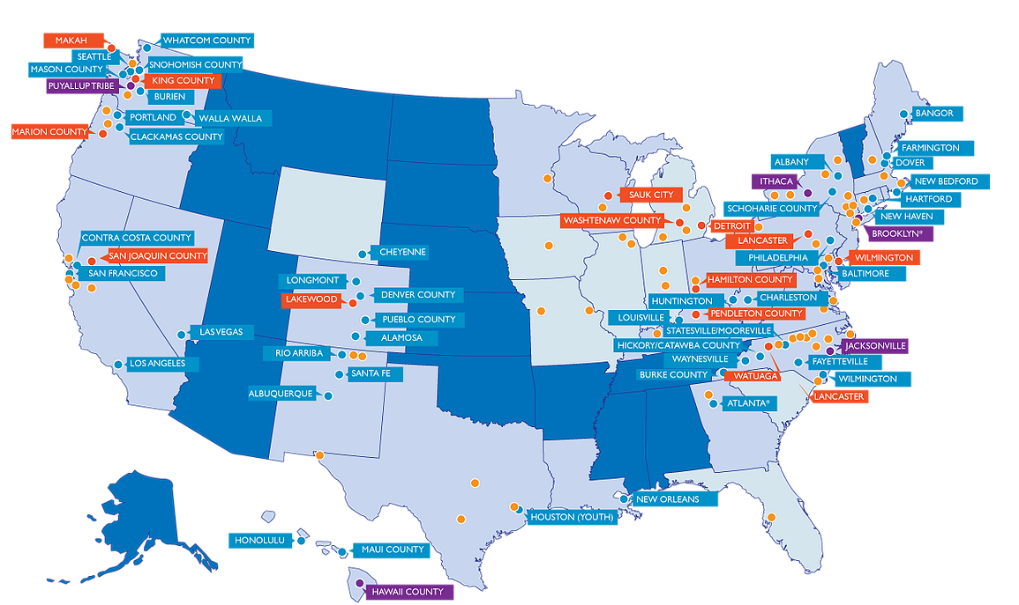
52 Operating Communities
7 Launching Communities
10 Developing Communities
27 Exploring Communities
2 International Communities
LEAD sites
Notes:
UK United Kingdom
ZA South Africa

Slide 3
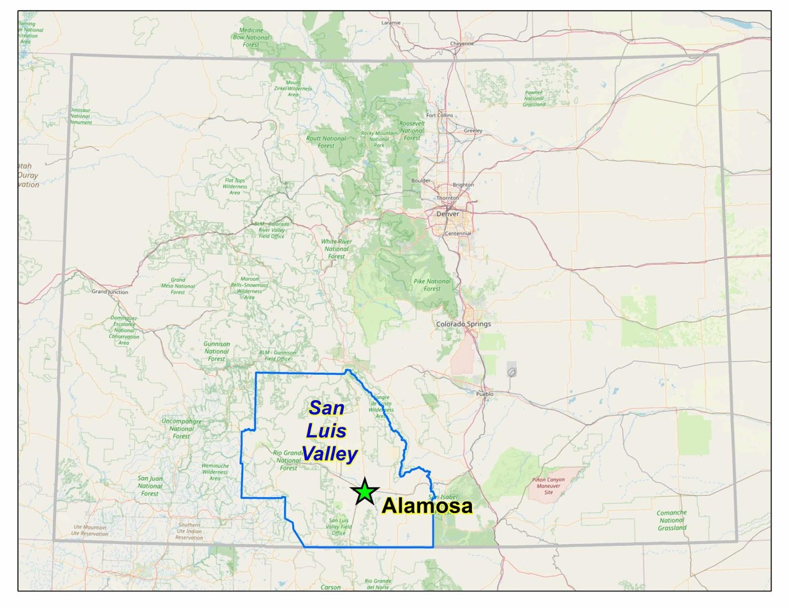
San Luis Valley
Valley population: 46,108
  122 miles long from north to south
  and 74 miles across = 8,193 square
  miles. Larger than the state of
  Massachusetts.
Incorporates 6 remote, rural and frontier counties
Largest Alpine Valley in the nation, surrounded by mountains
  Making this a geographically isolated region.
  Nearest urban center is 122 miles away, over a pass
High poverty rates
  3 of 6 counties identified as “persistent poverty”

Slide 4
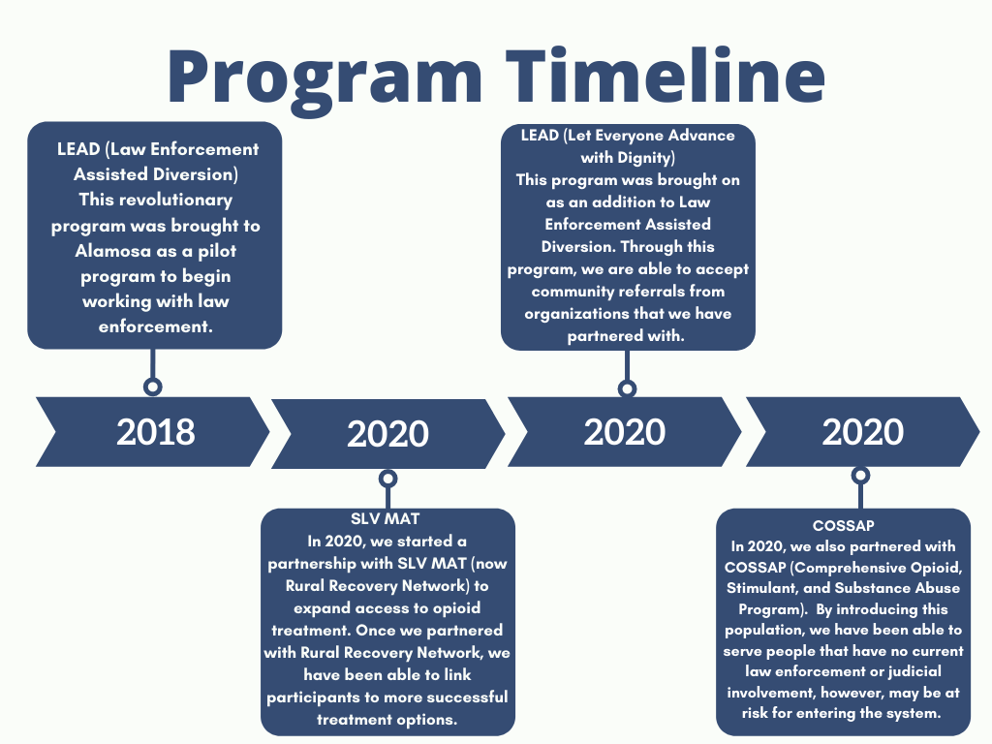

Slide 5
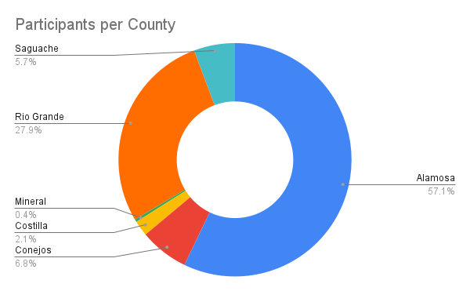

Slide 6
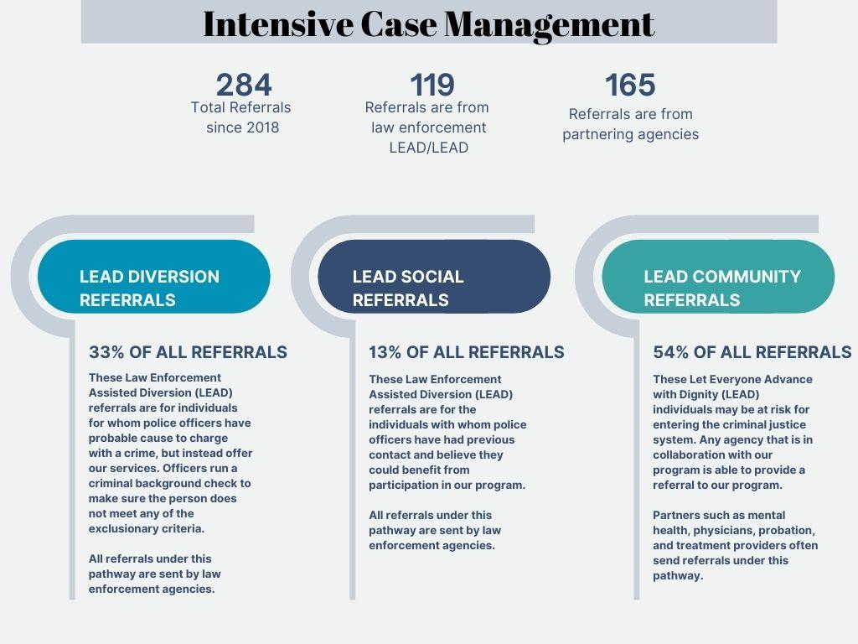

Slide 7
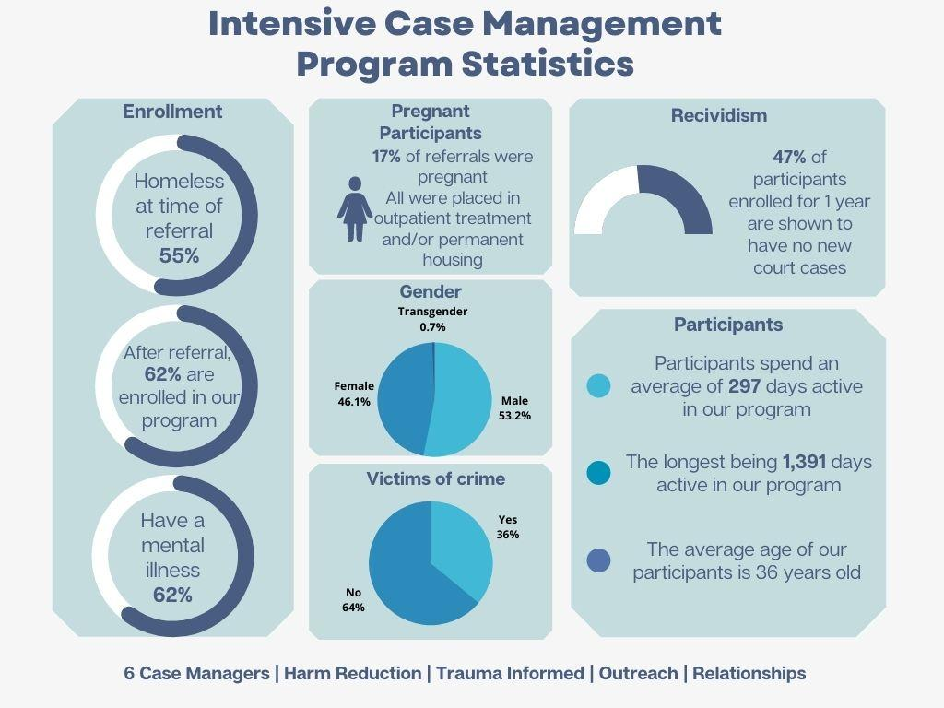

Slide 8
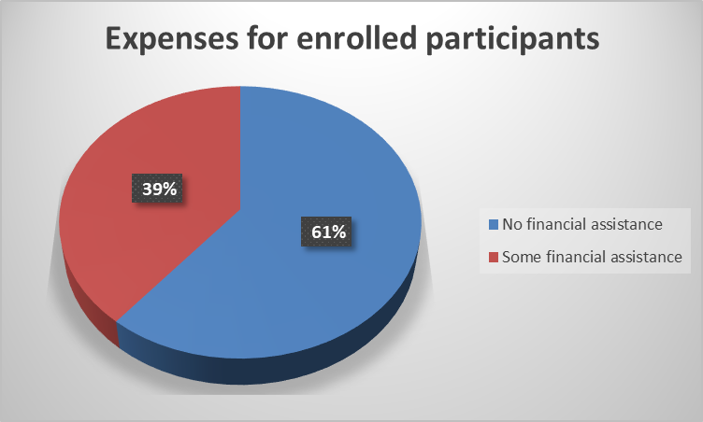

Slide 9
