Slide 1
The Douglas County Community Response Team a program of The Douglas County Mental Health Initiative

Slide 2
Goals of the CRT Program
Reduce emergency room visits for mental health crisis
1
Avoid jail for minor crimes committed due to mental illness
2
Connect clients to mental health, substance use and/or social determinant of health resources in the community
3

Slide 3
Youth CRT
The YCRT connects what is happening at school with what is happening at home and in the community.
The program is designed to improve communication between law enforcement including School Resource Officers (SROs), schools, the CRT teams, families and community providers.
A network of prevention and early intervention services are available for youth and families served by the Youth CRT. These resources were lined up by Human Services through an agreement with the Tennyson Center, but do not require formal system involvement.
Notes:
History and Basics: Background on the DCMHI including what it is and why it was established, as well as our partners and some examples of how DCMHI staff and programs partner with HS;
What is the DCMHI? What the DCMHI is not: The biggest takeaway for trainees.
Structure: How the DCMHI is set up
Overview of Program and other work. Additional trainings on DCMHI programs so we will not dive in here.
Staff

Slide 4
Youth CRT Outcomes

Slide 5
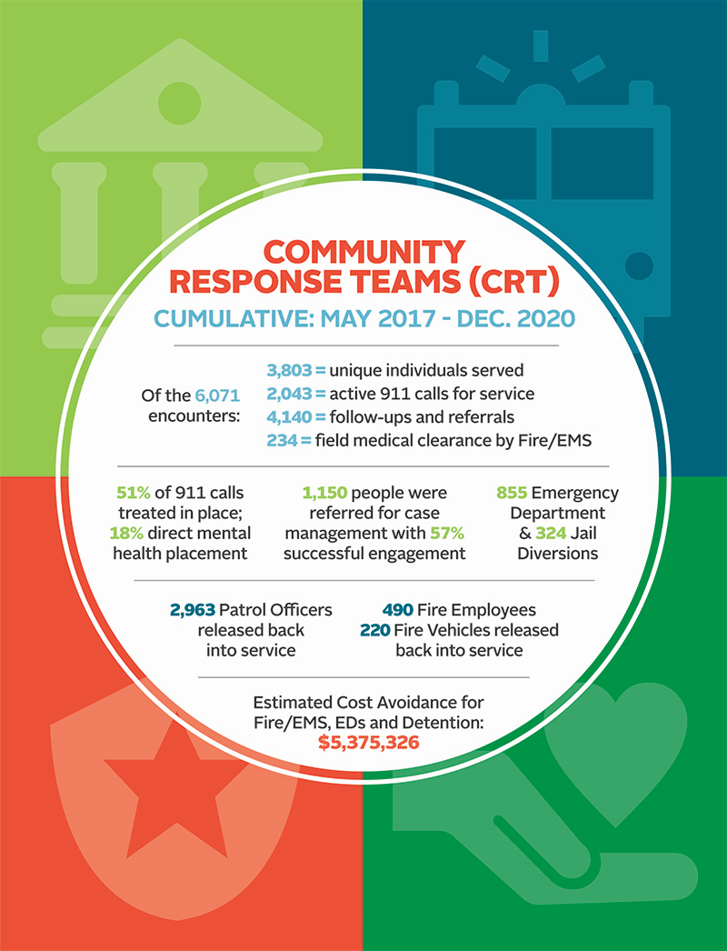
2020
Data
1278 Unique Individuals Served
654 Active 911 Responses
1369 CRT Referrals
2017 Successful Encounters
269 Emergency Department Saves
116 Jail Saves
71 M1’s
862 Officers Relieved
110 Fire Personnel Relieved
45 Fire Vehicles Relieved
40 POC testing

Slide 6
Partners
Caring Communities of Colorado, LLC
Castle Rock Fire and Rescue
Castle Rock Police Department
Douglas County Government
Douglas County School District
Douglas County Sheriff’s Office
Lone Tree Police Department
(referring partner)
Parker Police Department
South Metro Fire and Rescue

