Slide 1
Capitalizing on Collaboration
Carroll County Law Enforcement Assisted Diversion (LEAD)
Veronica Dietz, LCSW-C

Slide 2
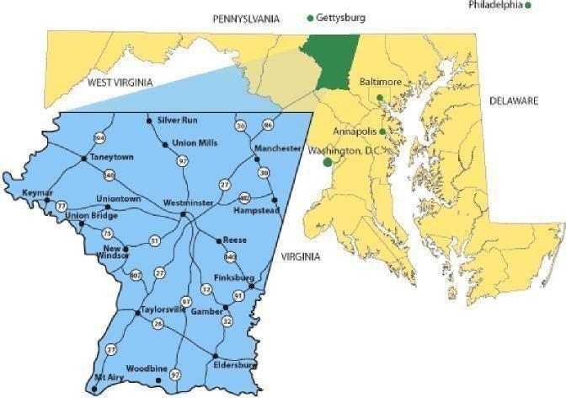
Notes:
Carroll County is located northwest of Baltimore City and has a total area of 453 square miles

Slide 3
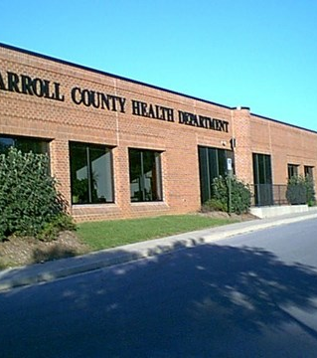
Carroll County Health Department Bureau of Prevention, Wellness, & Recovery
Notes:
I serve as the Director of Crisis Services here at the CCHD. Our Bureau of prevention wellness and recovery also serves as the county’s local behavioral health authority. My responsibilities include oversight and supervision of our re-entry team, working at our local detention center, monitoring the contract and service provision of our county’s mobile crisis team, I coordinator on the behavioral health side the county’s Crisis Intervention Team, I supervise a staff person who provides Urgent Care social worker, this is a credentialed staff person who provides same day next day assessments and provides screening to the public school system. Lastly I serve as the program manager for the county’s Law Enforcement Assisted diversion team.

Slide 4
Carroll County Maryland
Population 172,873
453 square miles
Median income $99,569 with approximately 5% people living in poverty.
Racial composition of the county:
91.7% Caucasian
3.9% Black or AA
3.9% Hispanic/ Latinx
2.5% AAPI
2% two or more races
50% of the county is in agricultural use.
Carroll County’s #1 industry is Agriculture.
Carroll ranks #1in Maryland for agricultural preservation.
Its county seat is the city of Westminster

Slide 5
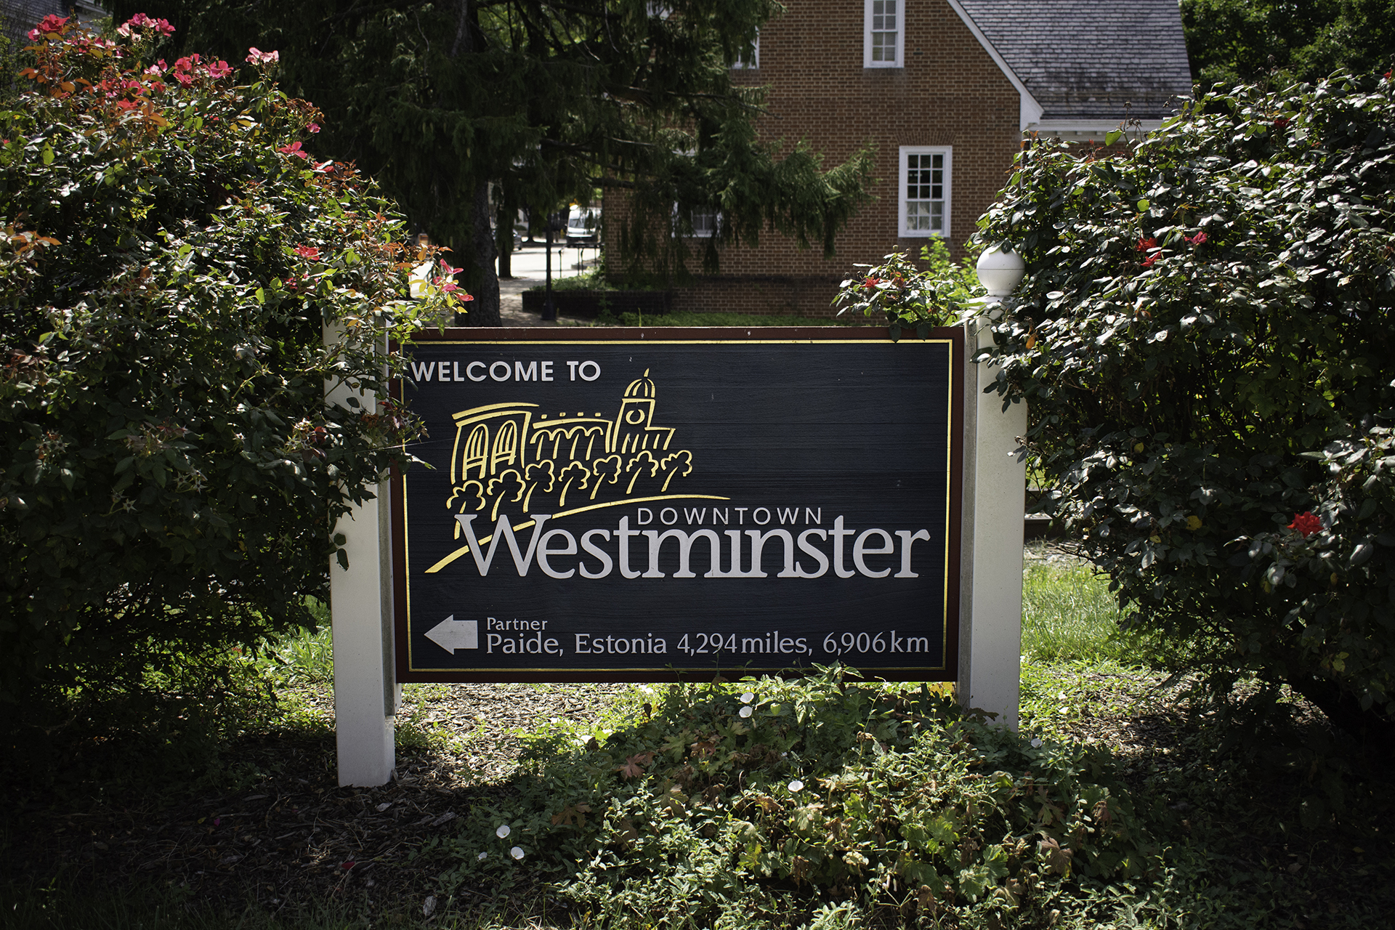
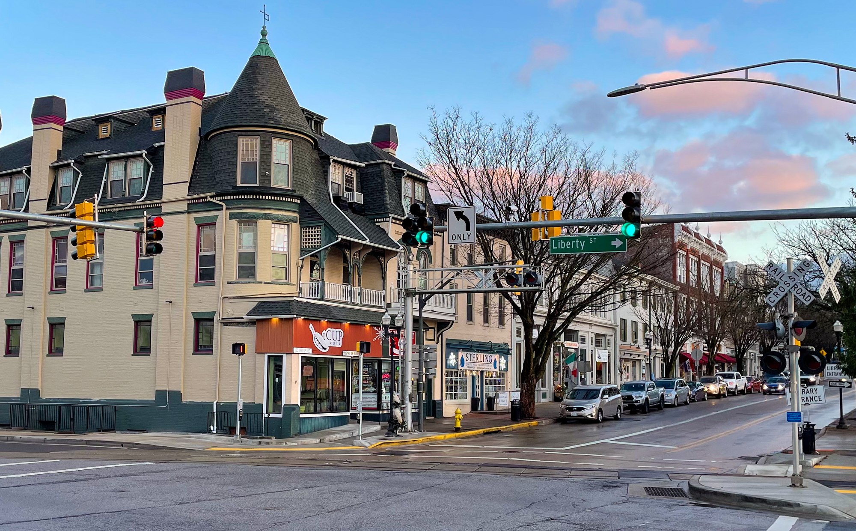
Notes:
Westminster serves as the county seat for Carroll County.

Slide 6
Westminster, Maryland
Population: 19,960
6.7 square miles
Median income: $64,399 with nearly 10% of people living in poverty
Racial composition of the city:
80.3% Caucasian
9.0% Black or AA
6.4% Hispanic/ Latinx
3.4% AAPI
4.6% two or more races
While Carroll County is still recognized as a rural community, the city of Westminster is faced with challenges not unlike other big cities.
In FY’18 Carroll County recorded 513 overdoses, of which nearly half were within the city limits.

Slide 7










The County that Collaborates

Slide 8
Carroll County Supports Criminal Justice Diversion
2007 - Carroll County Drug Treatment Court
2012 - Diversion Workgroup
2014 - Carroll County’s Crisis Intervention Team (CIT)
2016 - Carroll County State’s Attorney’s Office Early Intervention Program
2018 - Mobile Crisis Team

Slide 9
Law Enforcement Assisted Diversion
Our office learned about the LEAD program through the Governor’s Office of Crime Prevention Youth and Victim’s Services.
Start up funding came through the Maryland Department of Health’s Office of Harm Reduction Services via the Access Harm Reduction grant.
Carroll County became a sub-grantee of the Comprehension, Opioid, Stimulant and Substance Abuse Program grant.
The funding primarily funded our LEAD services team – Clinical Case Manager and Peer Recovery Specialist
The LEAD Support Bureau has been a critical element in supporting our ongoing development of the LEAD program.

Slide 10
Rollout of LEAD Program
Carroll County LEAD program rolled out into the its pilot area, Westminster City in August 2020.
Due to the pandemic our program was slow to engage participants.
We initially trained 3 Law Enforcement officers, as power users and our two-person services team.
Our team is co-located at the Police Department

Slide 11
Who’s at the table?
Westminster Police Department
Carroll County State’s Attorney’s Office
Office of the Public Defender
Parole and Probation
Carroll County Health Department – Services Team
Carroll County Health Department - Local Behavioral Health Authority
Operational Workgroup
This group meets bi-weekly and is comprised of individuals from each office who actualize the LEAD program.
Policy Coordinating Group
This is a group of decision-making representatives from each office. This group focuses on programming, policy and implementation.

Slide 12
Why LEAD?
Harm reduction approach
Trauma Informed
Intensive street-based outreach
No single agency ownership, but a collective community ownership.
Ongoing collaboration – everyone at the table is working towards the best interest of the participant

Slide 13
Carroll County LEAD Highlights
Carroll County LEAD program has engaged and enrolled 12 individuals.
In the last 3 months 1 participant withdrew from the program.
Our longest engaged participant (23 months) continues to receive support from our services.
The LEAD team has supported two participants who are receiving services outside of our jurisdiction.

Slide 14
Carroll County LEAD Data Fiscal Year 21
1 arrest diversion
4 social contact referrals
2 participants were arrested for a new crime (related to their ongoing behavioral health issue)
0 participants were arrested for a VOP
5 participants were seen in the Emergency Department
4 experienced an overdose
4 participants were connected to MAT

Slide 15
“Dozens of Calls for Service”
An early participant referred to LEAD as a social contact referral
WPD received many calls for service each week
In one month, the participant generated more than 20 calls for service.
Once engaged in the program the participant began working intensely with the services team.
WPD has seen a dramatic reduction in calls for services

Slide 16
“LEAD has changed my life”
Participant referred to LEAD in December 2021
Social Contact referral from WPD
WPD receiving numerous calls for service each week usually related to disturbance and disorderly behavior.
Struggling with an alcohol use disorder with a history of 2 recent attempts at treatment with no success
Began working with the services team who focused on harm reduction.
While there is still room for progress, he sees LEAD as the catalyst for his progress.

Slide 17
“Disentanglement of Criminal Justice and Behavioral Health”
The LEAD program is ideal when considering ways to disentangle criminal justice and behavioral health.
While LEAD was not originally designed to address behavioral health issues specifically, the core principals and goals do support this end goal.

Slide 18
Work still to be done
Continuing the work on addressing stigma and educating the community on behavioral health issues.
Engaging the local Chamber of Commerce increasing the buy-in community wide
The county’s Sheriff’s office as well as other municipal police agencies looking for alternate ways to engage individuals struggling with criminal justice involvement.
Community stakeholders – to give feedback and hold the LEAD team and program accountable to the community.
Notes:
Locally for our team and our goal of diverting from criminal justice involvement.

Slide 19
Work still to be done statewide
SB 857 – Establishing a Public Safety Behavioral Health Center of Excellence
Took effect July 1, 2021
Seeks to develop a strategic plan to increase treatment and reduce detention of those with behavioral health disorders.
Planning workshops using the Sequential Intercept Model (SAMHSA Gains).
Etc.
Greater Baltimore Regional Integrated Crisis System (GBRICS)
5-year $5 million dollar grant to create regional mobile response system where individuals in crisis can get services and supports without going through 911 and/or law enforcement.
Notes:
At the state level, Maryland is looking significantly at the idea of disentangling law enforcement and behavioral health.

Slide 20

Questions?

